Slide 1
Customer Defection
Ryan Erwin & John Herold
Customer Analytics Fall 2015

Slide 2
Overview
Predict whether or not an active customer will leave the company
To do so requires establishing a working definition of churn, which is when a customer ceases to be a customer. We define churn as:
A customer that has at least one active subscription during the period of interest (independent period) and does not renew or start a new subscription during the period of prediction (dependent period)
As with most tasks, great care must be taken to properly handle dates to ensure the independent period is not contaminated with dependent information
In addition, the definition of an active customer requires judgement and some careful thinking

Slide 3
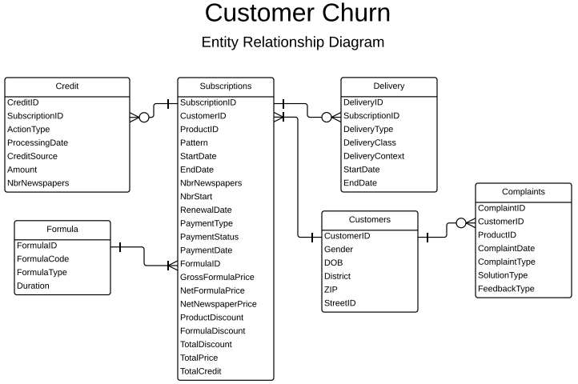
Business Understanding
Code link

Slide 4
Churn Model Structure
Subscription Start ✔
End Independent Period
Subscription End ✔
End Dependent Period
Subscription Start ✔
Dump date
Subscription Ends ✔
Dump date +
#days in Building Dependent period
Model Building
Model Deployment
Predict Churn
Calculate Churn

Slide 5
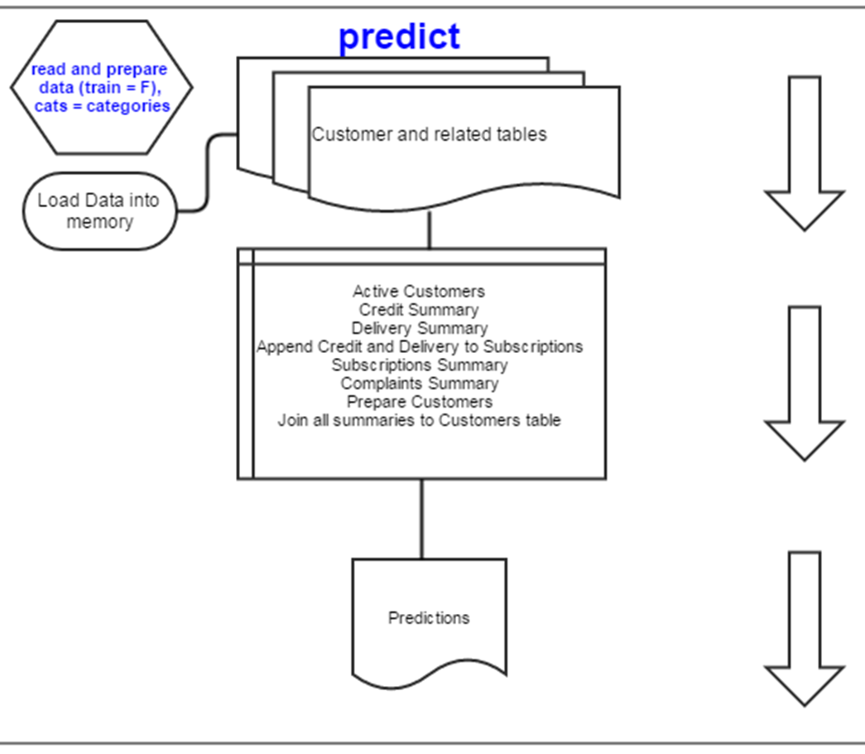
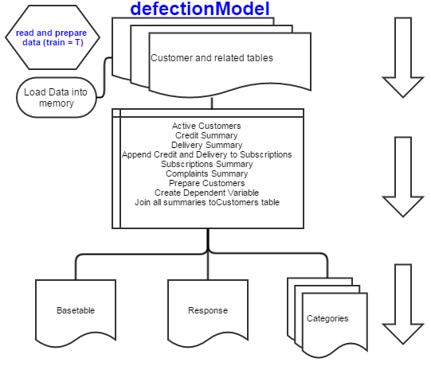
Code Flow – Training and Deployment
GitHub

Slide 6
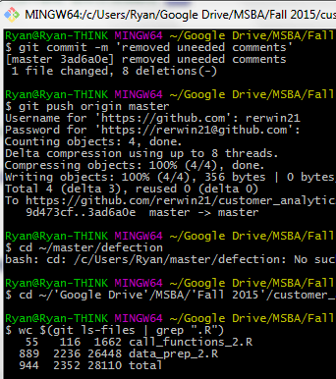
Code Evaluation – Length and Time
Running the code on Ryan’s PC (8GB RAM and Core i7) takes 44 seconds

Slide 7
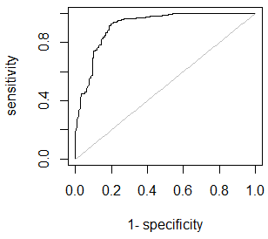
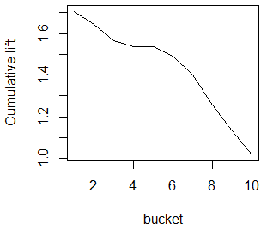
Model Evaluation – AUC and Lift
AUC - .91 to .96
Lift – 1.7

Slide 8
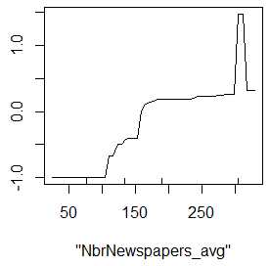
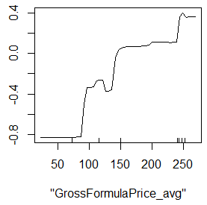
Model Evaluation – Partial Dependence

Slide 9

Q&A

